Slide 1

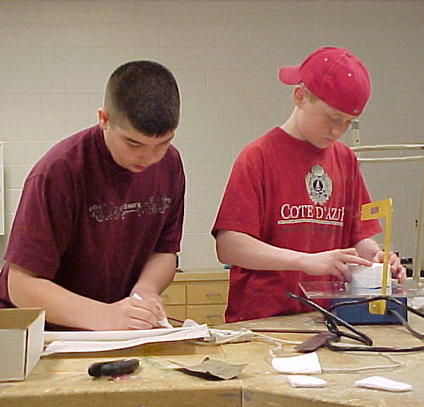
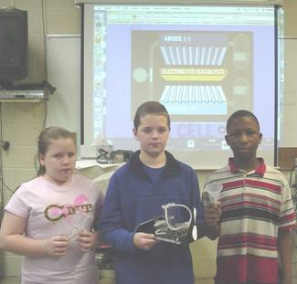




Advanced Design Applications
The Engineering Design Process
Teacher Resource – The First Five Days: Day 2
© 2014 International Technology and Engineering Educators Association
STEMCenter for Teaching and Learning™
Advanced Design Applications
Notes:
© International Technology Education Assoc
Slide #<number>
TITLE SLIDE
12/01/2009
STEMCenter for Teaching & Learning™ Engineering byDesign™

Slide 2

The BIG Idea
Big Idea:
The Engineering Design Process is an iterative method that people use to solve problems.
© 2014 International Technology and Engineering Educators Association
STEMCenter for Teaching and Learning™
Advanced Design Applications
Notes:
[Authors: Please include teacher notes appropriately.]
© International Technology Education Assoc
Slide #<number>
12/01/2009
STEMCenter for Teaching & Learning™ Engineering byDesign™

Slide 3

Defining Science
Science:
  Systematic knowledge of the physical or natural world gained through observation and experimentation.
  Focuses on how and why things happen.
  Scientists answer questions.
© 2014 International Technology and Engineering Educators Association
STEMCenter for Teaching and Learning™
Advanced Design Applications
Notes:
[Authors: Please include teacher notes appropriately.]
© International Technology Education Assoc
Slide #<number>
12/01/2009
STEMCenter for Teaching & Learning™ Engineering byDesign™

Slide 4

Defining Technology
Technology:
  Application of knowledge to solve practical problems or to change/manipulate the human environment.
  Focuses on making
  things happen.
  Engineers solve problems.
© 2014 International Technology and Engineering Educators Association
STEMCenter for Teaching and Learning™
Advanced Design Applications
Notes:
[Authors: Please include teacher notes appropriately.]
© International Technology Education Assoc
Slide #<number>
12/01/2009
STEMCenter for Teaching & Learning™ Engineering byDesign™

Slide 5
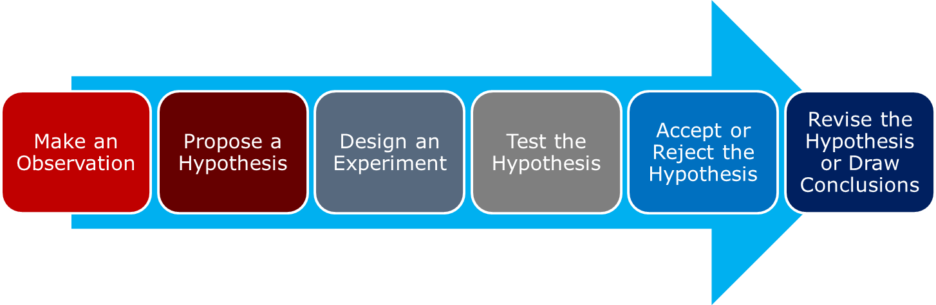
The Scientific Method
The Scientific Method is a linear method for conducting an investigation that involves making an observation and performing an experiment to test a hypothesis.
© 2014 International Technology and Engineering Educators Association
STEMCenter for Teaching and Learning™
Advanced Design Applications
Notes:
[Authors: Please include teacher notes appropriately.]
© International Technology Education Assoc
Slide #<number>
12/01/2009
STEMCenter for Teaching & Learning™ Engineering byDesign™

Slide 6

The Engineering Design Process
The Engineering Design Process is a systematic, iterative problem-solving method that produces solutions to meet human needs and wants.
Systematically applies
mathematics and science
to produce tangible
products that meet
human needs or wants.
© 2014 International Technology and Engineering Educators Association
STEMCenter for Teaching and Learning™
Advanced Design Applications
Notes:
[Authors: Please include teacher notes appropriately.]
© International Technology Education Assoc
Slide #<number>
12/01/2009
STEMCenter for Teaching & Learning™ Engineering byDesign™

Slide 7

The Engineering Design Process
Define Problem
Brainstorm Possible Solutions
Communicate Results
Research Ideas/ Explore Possibilities
Create/ Make Product
Define Problem
Test and Evaluate
Refine & Improve
Brainstorm
Ideas
Refine and
Improve
Specify Constraints and Identify Criteria
Generate a Solution
Explore Solutions
Test and Evaluate
Consider Alternative Solutions
Make a Model / Prototype
Develop a Written Design Proposal
Select An Approach
© 2014 International Technology and Engineering Educators Association
STEMCenter for Teaching and Learning™
Advanced Design Applications
Notes:
[Authors: Please include teacher notes appropriately.]
© International Technology Education Assoc
Slide #<number>
12/01/2009
STEMCenter for Teaching & Learning™ Engineering byDesign™

Slide 8
Engineering Design Process
Vs. Scientific Method
Match the term to either the Scientific Method or the Engineering Design Process
Defined Starting Point
Meets Human Need or Want
Continuous Improvement
Hypothesis
Linear Procedure
Involves Criteria and Constraints
Conduct Research
Follow a Process
© 2014 International Technology and Engineering Educators Association
STEMCenter for Teaching and Learning™
Advanced Design Applications
Notes:
[Authors: Please include teacher notes appropriately.]
© International Technology Education Assoc
Slide #<number>
12/01/2009
STEMCenter for Teaching & Learning™ Engineering byDesign™

Slide 9
Engineering Design Process
Vs. Scientific Method
The Scientific Method:
  Defined Starting Point
  Hypothesis
  Linear Procedure
  Conduct Research
  Follow a Process
The Engineering Design Process:
  Involves Criteria and Constraints
  Meets Human Need or Want
  Continuous Improvement
  Conduct Research
  Follow a Process
© 2014 International Technology and Engineering Educators Association
STEMCenter for Teaching and Learning™
Advanced Design Applications
Notes:
[Authors: Please include teacher notes appropriately.]
© International Technology Education Assoc
Slide #<number>
12/01/2009
STEMCenter for Teaching & Learning™ Engineering byDesign™

Slide 10
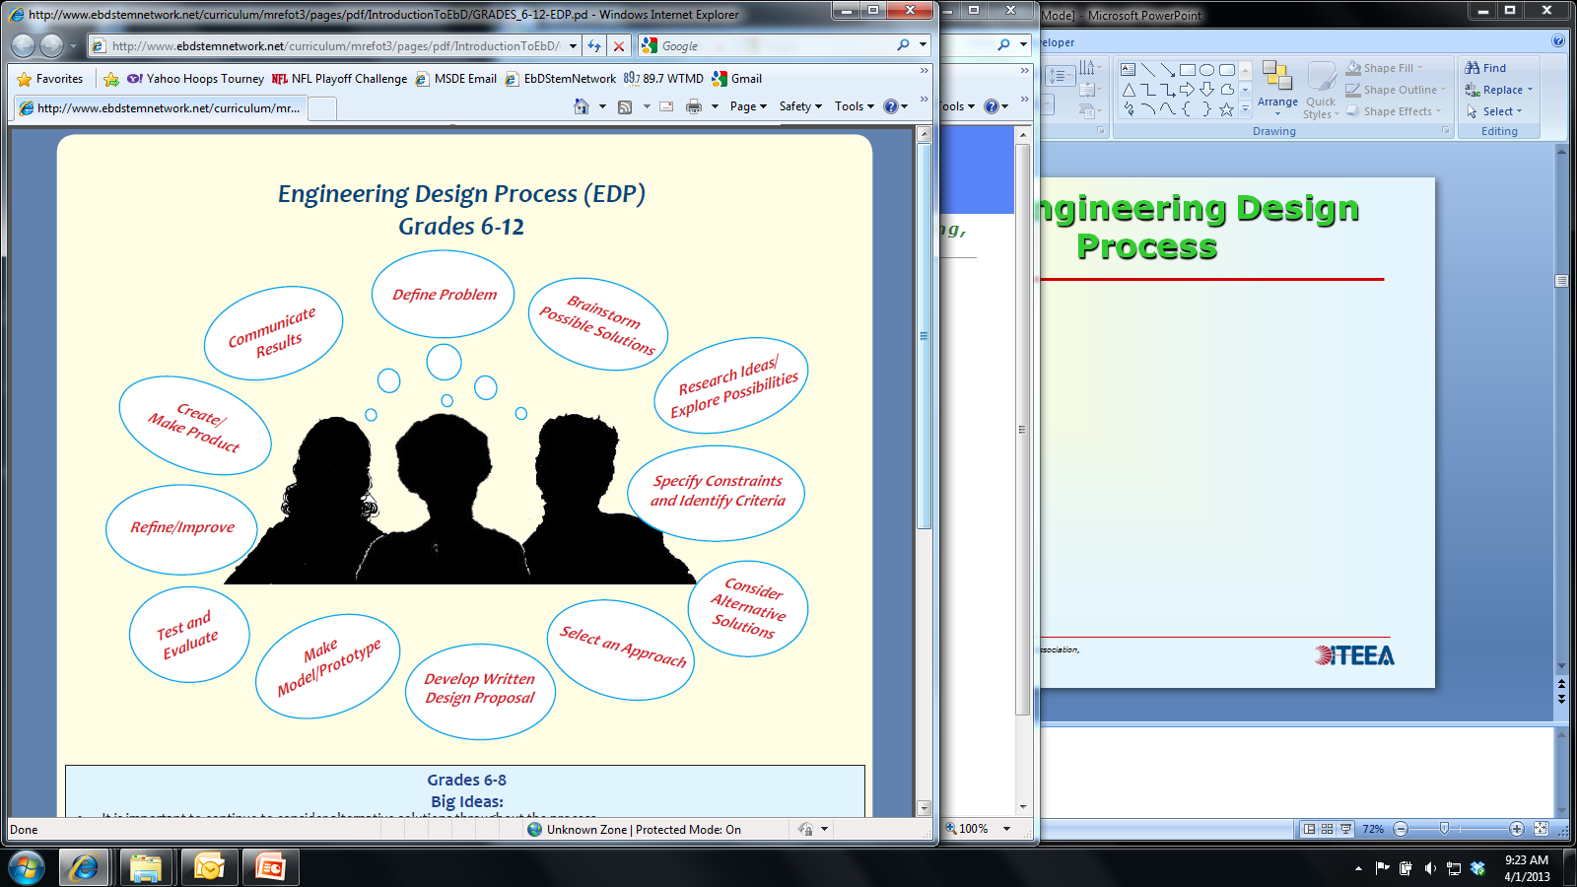
The Engineering Design Process
Use the
Engineering
Design
Journal to
record each
step in the
Engineering
Design
Process.
© 2014 International Technology and Engineering Educators Association
STEMCenter for Teaching and Learning™
Advanced Design Applications
Notes:
[Authors: Please include teacher notes appropriately.]
© International Technology Education Assoc
Slide #<number>
12/01/2009
STEMCenter for Teaching & Learning™ Engineering byDesign™

Slide 11

Define the Problem
Develop a problem statement that identifies the what, who, when, and how the problem should be addressed.
The problem statement
should be short, descriptive,
and referenced as you
work through the
Engineering Design
Process.
© 2014 International Technology and Engineering Educators Association
STEMCenter for Teaching and Learning™
Advanced Design Applications
Notes:
[Authors: Please include teacher notes appropriately.]
© International Technology Education Assoc
Slide #<number>
12/01/2009
STEMCenter for Teaching & Learning™ Engineering byDesign™

Slide 12

Brainstorming Solutions
When working as a group, record your ideas and employ the rules of brainstorming:
  One conversation at a time; stay focused.
  Encourage wild ideas,
  quantity vs. quality.
  Defer judgment and
  build on the ideas of others.
Use Mind Mapping, the da Vinci Method, or Inventive Problem Solving as appropriate.
© 2014 International Technology and Engineering Educators Association
STEMCenter for Teaching and Learning™
Advanced Design Applications
Notes:
[Authors: Please include teacher notes appropriately.]
© International Technology Education Assoc
Slide #<number>
12/01/2009
STEMCenter for Teaching & Learning™ Engineering byDesign™

Slide 13
Research Ideas/
Explore Possibilities
Research is essential in determining the best possible solution.
Identify how the problem or a similar problem was addressed in the past.
Determine what mathematical and/or scientific background knowledge is essential to solve the problem.
© 2014 International Technology and Engineering Educators Association
STEMCenter for Teaching and Learning™
Advanced Design Applications
Notes:
[Authors: Please include teacher notes appropriately.]
© International Technology Education Assoc
Slide #<number>
12/01/2009
STEMCenter for Teaching & Learning™ Engineering byDesign™

Slide 14
Specify Constraints and
Identify Criteria
Good design follows a set of given or identified criteria and constraints:
  Criteria = Guidelines
  Constraints = Limitations
Document the essential criteria and constraints needed to solve the problem.
© 2014 International Technology and Engineering Educators Association
STEMCenter for Teaching and Learning™
Advanced Design Applications
Notes:
[Authors: Please include teacher notes appropriately.]
© International Technology Education Assoc
Slide #<number>
12/01/2009
STEMCenter for Teaching & Learning™ Engineering byDesign™

Slide 15

Consider Alternative Solutions
Always consider alternative solutions and DO NOT allow preconceptions to limit your ideas.
  It is important to stay
  open-minded.
    Compare each of your
    design ideas with the
    criteria and constraints
    to determine how well
    they solve the problem.
© 2014 International Technology and Engineering Educators Association
STEMCenter for Teaching and Learning™
Advanced Design Applications
Notes:
[Authors: Please include teacher notes appropriately.]
© International Technology Education Assoc
Slide #<number>
12/01/2009
STEMCenter for Teaching & Learning™ Engineering byDesign™

Slide 16
Select An Approach
Determining the “best” solution will involve trade-offs.
The “best” solution should:
  Align to the problem statement.
  Meet the identified criteria and constraints.
Use a Decision Matrix to help identify the best solution.
© 2014 International Technology and Engineering Educators Association
STEMCenter for Teaching and Learning™
Advanced Design Applications
Notes:
[Authors: Please include teacher notes appropriately.]
© International Technology Education Assoc
Slide #<number>
12/01/2009
STEMCenter for Teaching & Learning™ Engineering byDesign™

Slide 17
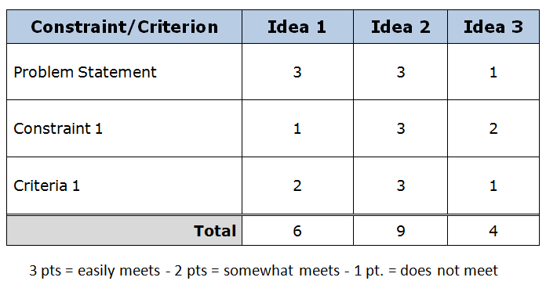
Select An Approach
The Decision Matrix is a simple way to chart your proposed solutions (x axis) against the requirements (y axis).
Establish a
point scale
to help
determine
the “best”
idea.
x
y
© 2014 International Technology and Engineering Educators Association
STEMCenter for Teaching and Learning™
Advanced Design Applications
Notes:
[Authors: Please include teacher notes appropriately.]
© International Technology Education Assoc
Slide #<number>
12/01/2009
STEMCenter for Teaching & Learning™ Engineering byDesign™

Slide 18
Develop a Written Design Proposal
Once an idea has been selected, it is important to develop a plan of action.
A Design Proposal is a way to manage simple projects, which includes:
  The who, what, when, where, and how to deliver the work.
  Often includes descriptions, sketches, and technical drawings.
  Begin to plan how the solution will be evaluated.
© 2014 International Technology and Engineering Educators Association
STEMCenter for Teaching and Learning™
Advanced Design Applications
Notes:
[Authors: Please include teacher notes appropriately.]
© International Technology Education Assoc
Slide #<number>
12/01/2009
STEMCenter for Teaching & Learning™ Engineering byDesign™

Slide 19

Develop a Written Design Proposal
When developing a design proposal, you will need to plan ahead to determine how you will evaluate your design.
  What tests will be conducted to
  determine if criteria are being met?
  What data will be collected?
  How will those data be used to
  improve the solution?
© 2014 International Technology and Engineering Educators Association
STEMCenter for Teaching and Learning™
Advanced Design Applications
Notes:
[Authors: Please include teacher notes appropriately.]
© International Technology Education Assoc
Slide #<number>
12/01/2009
STEMCenter for Teaching & Learning™ Engineering byDesign™

Slide 20
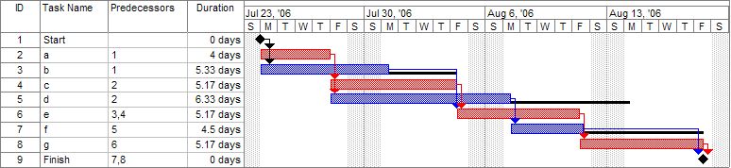
Develop a Written Design Proposal
Larger projects may require the use of a project management technique or a Gantt Chart.
A Gantt Chart is a type of bar chart that shows a schedule of when/how the project can be completed.
© 2014 International Technology and Engineering Educators Association
STEMCenter for Teaching and Learning™
Advanced Design Applications
Notes:
[Authors: Please include teacher notes appropriately.]
© International Technology Education Assoc
Slide #<number>
12/01/2009
STEMCenter for Teaching & Learning™ Engineering byDesign™

Slide 21

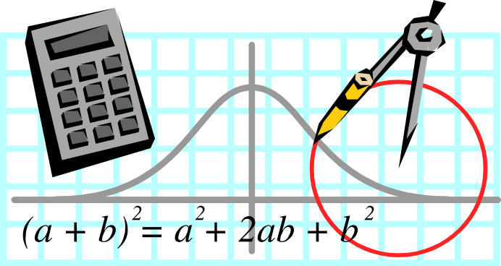

Make a Model/Prototype
Models can be conceptual, mathematical, or physical.
© 2014 International Technology and Engineering Educators Association
STEMCenter for Teaching and Learning™
Advanced Design Applications
Notes:
[Authors: Please include teacher notes appropriately.]
© International Technology Education Assoc
Slide #<number>
12/01/2009
STEMCenter for Teaching & Learning™ Engineering byDesign™

Slide 22
Make a Model/Prototype
Conceptual models are abstract models that use language and graphic-based representations to convey meaning.
They can include:
  Technical Writing
  Graphs and Charts
  Annotated Sketches
  Technical Drawings
© 2014 International Technology and Engineering Educators Association
STEMCenter for Teaching and Learning™
Advanced Design Applications
Notes:
[Authors: Please include teacher notes appropriately.]
© International Technology Education Assoc
Slide #<number>
12/01/2009
STEMCenter for Teaching & Learning™ Engineering byDesign™

Slide 23
Make a Model/Prototype
Mathematical models are abstract models that use the language of mathematics to describe the behavior of the solution.
They can include:
  Statistical models
  Differential equations
  Game theoretic models
  (computer simulation)
© 2014 International Technology and Engineering Educators Association
STEMCenter for Teaching and Learning™
Advanced Design Applications
Notes:
[Authors: Please include teacher notes appropriately.]
© International Technology Education Assoc
Slide #<number>
12/01/2009
STEMCenter for Teaching & Learning™ Engineering byDesign™

Slide 24
Make a Model/Prototype
Physical models are three-dimensional models that represent the solution.
They can include:
  Mock-Up – a representation
  of the final solution that
  does not function.
  Prototype – performs the
  final solution and can be
  used for testing/evaluation.
© 2014 International Technology and Engineering Educators Association
STEMCenter for Teaching and Learning™
Advanced Design Applications
Notes:
[Authors: Please include teacher notes appropriately.]
© International Technology Education Assoc
Slide #<number>
12/01/2009
STEMCenter for Teaching & Learning™ Engineering byDesign™

Slide 25
Test and Evaluate
Project planning and evaluation go hand-in-hand.
Based on the information you projected in your design proposal you will:
  Record and analyze results
  Correct problems with the
  design that are discovered
  during testing
© 2014 International Technology and Engineering Educators Association
STEMCenter for Teaching and Learning™
Advanced Design Applications
Notes:
[Authors: Please include teacher notes appropriately.]
© International Technology Education Assoc
Slide #<number>
12/01/2009
STEMCenter for Teaching & Learning™ Engineering byDesign™

Slide 26
Refine/Improve
Employ data-driven decision making.
  Use the data collected during the test and evaluate phase to justify improvements to the solution.
The solution should be continuously improved as you move through the Engineering Design Process.
  Remember to document all project improvements in your journal.
© 2014 International Technology and Engineering Educators Association
STEMCenter for Teaching and Learning™
Advanced Design Applications
Notes:
[Authors: Please include teacher notes appropriately.]
© International Technology Education Assoc
Slide #<number>
12/01/2009
STEMCenter for Teaching & Learning™ Engineering byDesign™

Slide 27

Create/Make Product
Working independently or in a group, develop the final physical solution.
  The final solution
  should represent
  the revision made
  as you followed the
  Engineering
  Design Process.
  The product produced
  should clearly reflect refinements made
  to the design throughout the process.
© 2014 International Technology and Engineering Educators Association
STEMCenter for Teaching and Learning™
Advanced Design Applications
Notes:
[Authors: Please include teacher notes appropriately.]
© International Technology Education Assoc
Slide #<number>
12/01/2009
STEMCenter for Teaching & Learning™ Engineering byDesign™

Slide 28
Communicate the Results
Use the Engineering Design Journal to record and document each step in the Engineering Design Process.
A more formal presentation or demonstration of the solution may be required, which should:
  Summarize your work (includes problem statement, design proposal, evaluation methods, etc…)
  Highlight why you chose the final solution.
© 2014 International Technology and Engineering Educators Association
STEMCenter for Teaching and Learning™
Advanced Design Applications
Notes:
[Authors: Please include teacher notes appropriately.]
© International Technology Education Assoc
Slide #<number>
12/01/2009
STEMCenter for Teaching & Learning™ Engineering byDesign™

